Slide 1
Sustainable Solutions For Greener Tomorrow

Slide 2
Corporate Structure
Revolve Group
Revolve Engineers
Started in 1995
Trading Division
Revolve Engineers Pvt. Ltd
Started in 1999
Projects Division

Slide 3
Milestones
M/S. Thermax Culligan
Selected Revolve As Their Distributor For Andhra And Telangana Regions.
Revolve Engineers Pvt. Ltd. Was Established To Handle Projects Division.
REVOLVE ENGINEERS
Journey Started
1995
1997
1999
1999
2002
Revolve Engineers Established Started As Authorized Distributer For ABB, Microfinish Pumps.
M/S. Grundfos Appointed Revolve Engineers As Distributor For Sales And Service For Andhra Pradesh And Telangana Regions.
Pentair Water Has Appointed Revolve Engineers As Their Regional Distributor To handle Their Components and Hydranautics Membranes.

Slide 4
Milestones
ACO India Has Authorized Revolve Engineers as their Channel partner
Revolve Group Coorporate Office Was Established at Sanath Nagar, Hyderabad
Revolve Engineers Started Distribution of Thermobreak Insulations.
Geberit Has Appointed Revolve Engineers as Channel Partner for Andhra and Telangana Regions.
2010
2012
2018
2019
2021
Revolve Engineers Warehouse Is Established In Pashamylaram.
Global Water Has Aurthorized Revolve Engineers as their Channel partner for Diaphram Tanks.
Revolve Engineers Pvt. Ltd. Is ventured into Govt. affiliated Projects.

Slide 5
Authorized Distributers
M/S ABB MOTORS
M/S ACO
M/S A.O.Smith
M/S DAIKI AXIS
M/S GEBERIT
M/S GLOBAL
M/S GRUNDFOS
M/S MICROFINISH
M/S PENTAIR
M/S THERMOBREAK

Slide 6
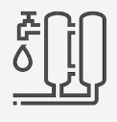
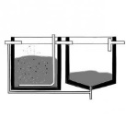
Product Portfolio
Water Treatment Plants (WTP)
Sewage Treatment Plants (STP)
Ultra Filtration Systems
Nano Filtration Systems
RO Systems
Purified Water Generation
DM / DI Systems
Filtration Systems
Softening Systems
Activate Sludge Process
Moving Bed Bio Reactor
Sequential Batch Reactor
Membrane Bio Reactor
Effluent Treatment Plants (ETP)
Hot Water Generation Systems
O&M and AMC Services

Slide 7
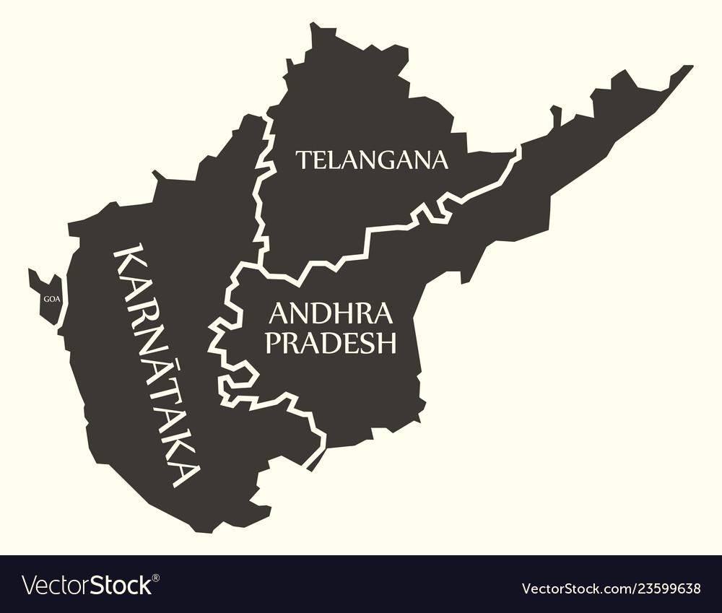
Business Locations
Head office :
C-7&8, I.D.A. Sanath Nagar, Hyderabad- 500018 (Telangana)
Branches:
Vijayawada (Andhra Pradesh)
Vishakhapatnam (Andhra Pradesh)
Bengaluru (Karnataka)
Warehouse:
Sanath Nagar, Hyderabad (Telangana)
Pashamylaram, Hyderabad (Telangana)

Slide 8
Our Strength
28, year-old company, Estd. in 1995, Group turnover - FY22-23 : > INR 130 Cr (approx. USD 16 Million)
Well- qualified execution team – Average Qualification of Engineering Graduation. The best blend of experience 70% of employees are under the age of 35, 75% are Engineering graduates and above.
ISO 9001-2015 Certified company.
20,000 Sq. ft. of storage area ( 350,000 Cu. ft. of storage volume)
Labour law compliant - One of the first and very few water treatment companies to be compliant with all labour laws providing PF, ESI, Group health cover, accidental insurance tom all our employees and having framed strictly implemented guidelines for workplace policies.

Slide 9
STP Projects Executed
ASP Technology – 100+ Projects ( 50KLD to 150KLD)
MBBR Technology – 100+ Projects ( 10KLD to 400KLD)
SBR Technology – 200+ Projects ( 40KLD to 2MLD)
MBR Technology- 20 + projects (50 KLD -500 KLD)

Slide 10
Sectors
INDUSTRIAL:
Pharmaceutical
Food & Beverages
Distilleries
Pulp & Paper
Breweries
Textile & Spinning
Biotech
Tobacco & Rubber
Power
Cement & Infrastructure
COMMERCIAL:
Hospitals
Star Hotels
Malls & Multiplex
Group Housing
Software Companies
Banks
Government office Complexes
Educational Institutions

Slide 11
Group Financials
( Rs. In Millions)
Projected

Slide 12
Our Clients
L&T Metro Rail- Hyderabad
Microsoft India-Hyderabad
Amazon-Hyderabad
Salarpuria Sattva
Infosys
Aparna Constructions
My Home
Rajapushpa
GAR
IJM
Vazra Nirman
Vamsi Ram Projects
SRM University
Raheja Mind Space
Lemon Tree Hotels
Taj Vivanta.
Hallmark Projects
SBI Bank, Gachibowli
M/s. HAL
M/s. DRDO
M/s. Bharat Dynamics Limited
M/s. NRSC
M/s. Continental Hospitals
Divis Laboratory
Emmennar Pharma
Symed Laboratories
Dr. Reddy’s Laboratories
Hetero Laboratories
Aurobindo Pharma
Meenakshi
Matrix Laboratories
M/s. Bharat Dynamics Limited
M/s. Research Center Imarat (RCI)
P&G- Hyderabad
Cola Cola-Hyderabad
Citron
Sreenidhi
Tech mahindra

Slide 13
Our Esteemed Clients

Slide 14
SAVE WATER SAVE EARTH THANK YOU

